Slide 1
1 - Devops
presentation
By Hugo Lachkar

Slide 2
01
02
03
04
05
06
Positions in the company
What is a Devops ?
What does a Devops ?
Technologies used by a Devops
Devops in the world
What after this presentation

Slide 3
Position in the company

Slide 4
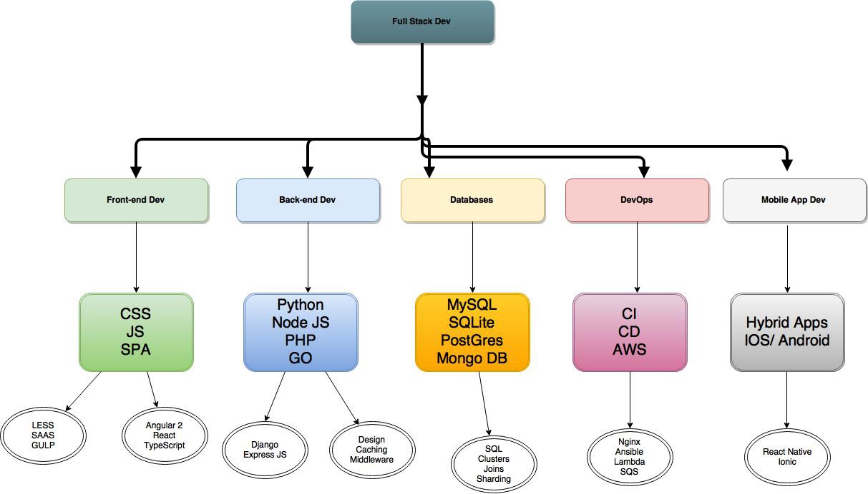

Slide 5
Devops ?
DevOps is a set of practices that combines software development (Dev) and IT operations (Ops).

Slide 6
What does a Devops ?

Slide 7


Slide 8
Technologies used by a devops ?

Slide 9
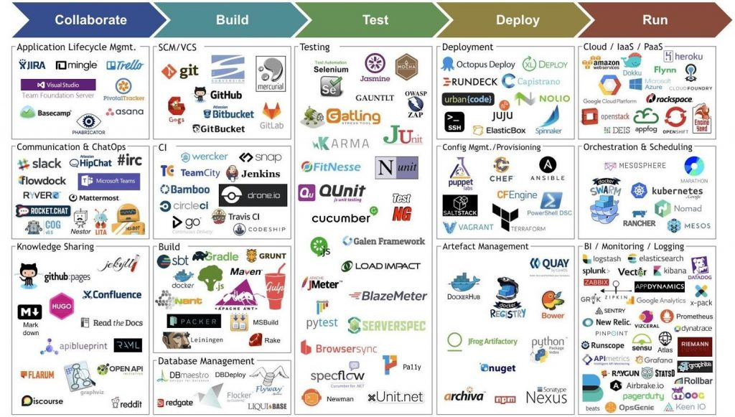

Slide 10
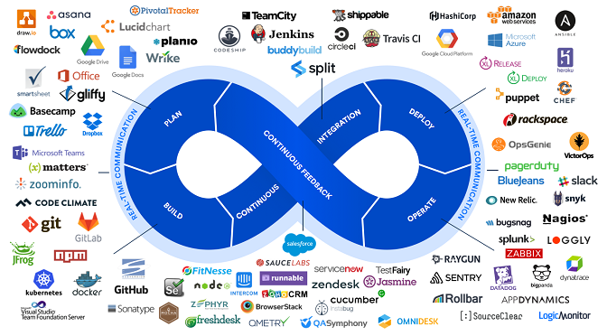

Slide 11
DevOPs in the world

Slide 12
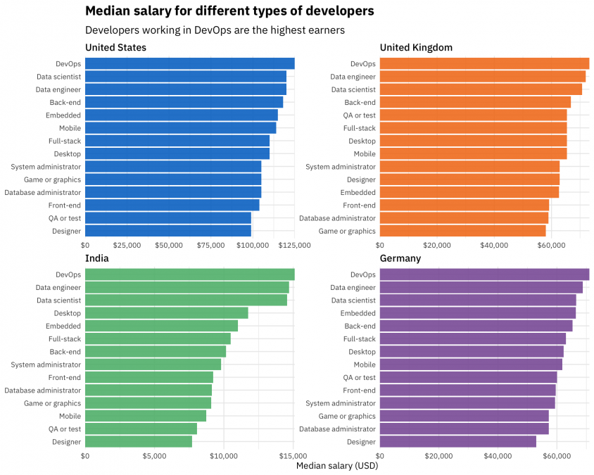
In 2020

Slide 13
What after this presentation ?
01
02
Workshop Docker
Talk: Other technologies

Slide 14
THANKS
Does anyone have any questions?
hugo1.lachkar@epitech.eu
hugolachkar.com

